Slide 1
Augmenting Base LLMs

Slide 2
Augmenting LLMs
There are a number of ways to augment LLMs.
We focus on three different methods:
Finetuning
Prompting
Knowledge endowment
Notes:
So far, we have mainly talked about pretraining. This pretraining produces what we call the base or foundation model. These models, in particular generative models, are not always useful. At this point, they are simply very expensive sentence completion algorithms. Although, some of the larger models will still be able to do question answering or follow instructions, it helps to first finetune the model for this specific task.
Once the model is finetuned, there are some optimal ways that you might be able to elicit the best information out of chat models. In modern times, this has been given the name prompt engineering.
Finally, we can also endow the model with access to external knowledge bases or tools.

Slide 3
Finetuning base model
General LARGE training data
Small
training data
BASE LLM
Finetuned LLM
Notes:
We start with a general outline of the finetuning process.
We first train the base model with a massive amount of data to obtain the base LLM. In order to finetune the model for a specific task, such as chat or instruction following, we get a smaller dataset, and just apply the same process! It is really that simple!
There are some caveats here:
- When training a model, you make the assumption that the training data is roughly independent and identically distributed. For example, if you were training a model on multiple languages, you want to avoid first training the model with all of the English examples, then all of the French examples, etc. Because by the time you get to the end of your training data, the model has forgotten the first lot of examples!
- The base model has been conditioned on a massive amount of text, but we don’t want to alter the weights of the model too much, because then we might “forget” some of the original information that we learnt (a phenomenon called catastrophic forgetting).
- Typically, the finetuning dataset is usually significantly smaller than the pretraining dataset, and finetuning is therefore a much cheaper process. It is never intended to override any of the model’s base knowledge, it is rather meant to “guide” the model to exhibit a particular behavior or style.
What are some ways we can finetune some models then?

Slide 4

Domain-Specific Finetuning of a Base Model
E.g. finetuning on Parliament sessions
https://hansard.parliament.uk/
May be done using a method like LoRA
Notes:
One thing that we can do is finetune on domain-specific data. For example, we might want to finetune a model on parliamentary sessions, so that the model will have some knowledge of parliamentary proceedings, or to talk in the style of someone presenting in parliament.
It is very expensive to train all the weights in a model, so typically some are either frozen, or advanced techniques such as Low Rank Adaptation is used

Slide 5
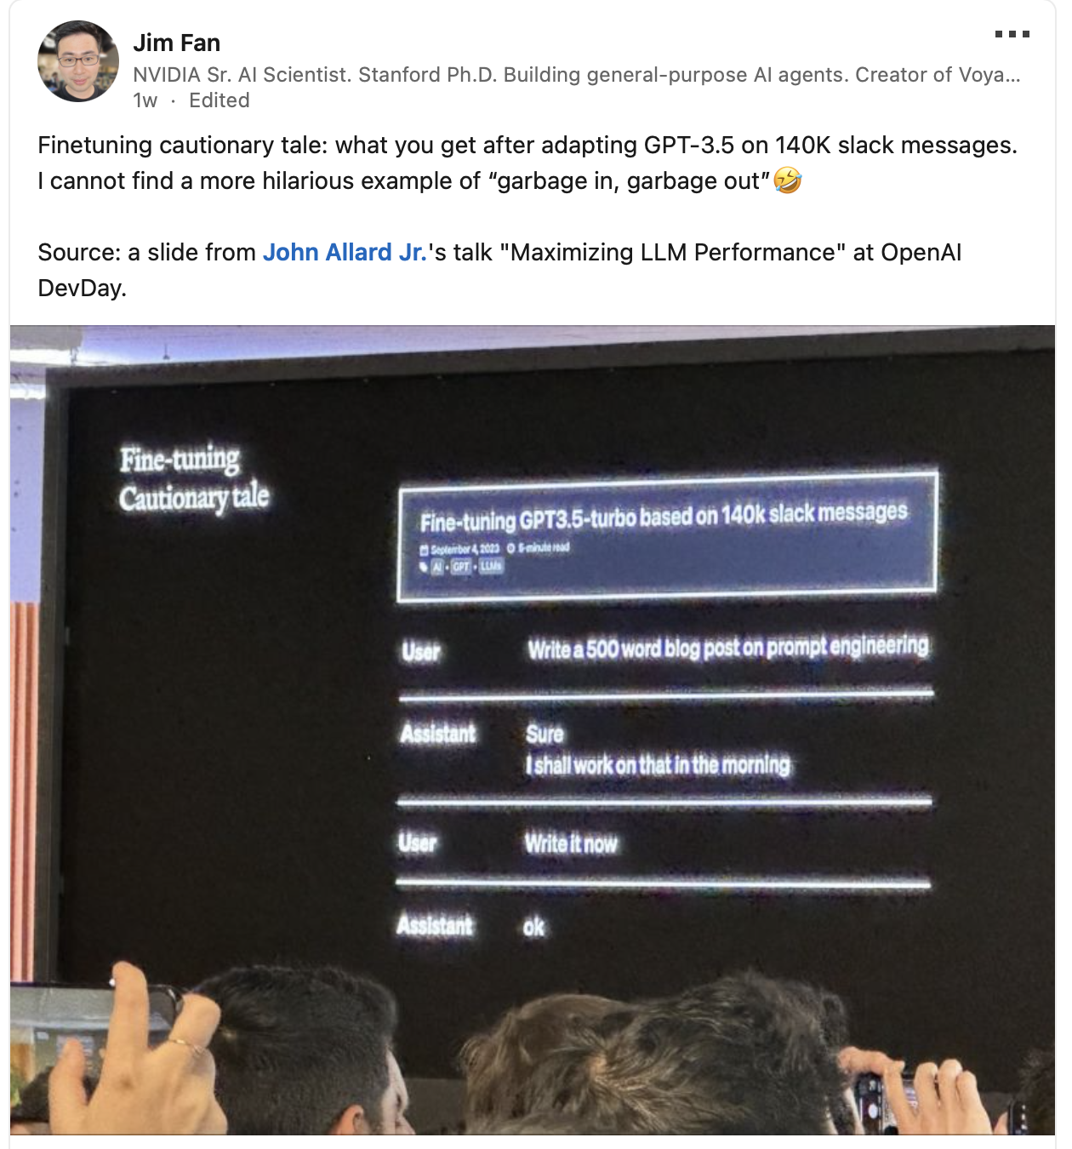
A Cautionary Tale
Pitfalls of LLMs include:
Bias
Hallucination
Static/fixed in time
Notes:
We have to be careful though! Here is an example of GPT-3.5-turbo trained on slack messages.

Slide 6
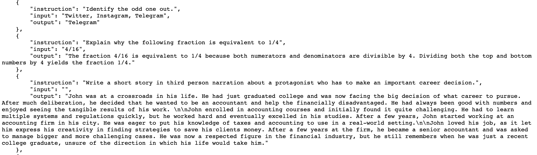
Instruction Tuning (IT)
See e.g. Stanford's Alpaca data
https://github.com/tatsu-lab/stanford_alpaca
Notes:
We might want to endow the model with a chat-like behavior, or to be able to follow instructions in the form of:
“Do X for me.”
The Alpaca dataset is a large instruction-tuning dataset, where the model is present with text of the following form.
This data is then fed into the model in the same way as you would feed in the pretraining data, and the model learns this conversational, instructional style. For example when you type into the text box on an LLM, the model will be fed the following prompt.
Your input to the text box: “Tell me a story about a duck.”
The model will receive as input:
{
“Instruction: tell me a story about a duck.
Output: “
}
The model is still doing text completion, but it has learned the style of question answering.

Slide 7
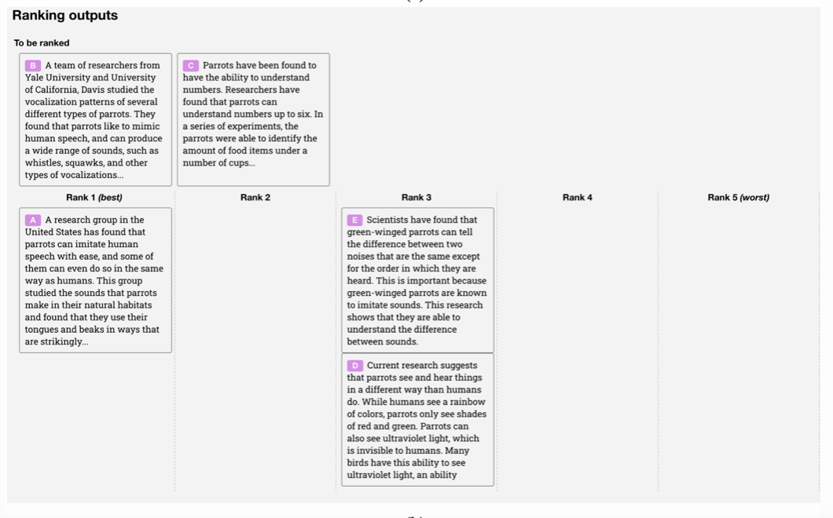
Reinforcement Learning from Human Feedback (RLHF)
Notes:
It is often easier for a human to compare answers than for a human to write an exemplar answer.
We, as humans, can compare answers and rank the answers, and then we can further finetune the model using these high quality question response pairs

Slide 8
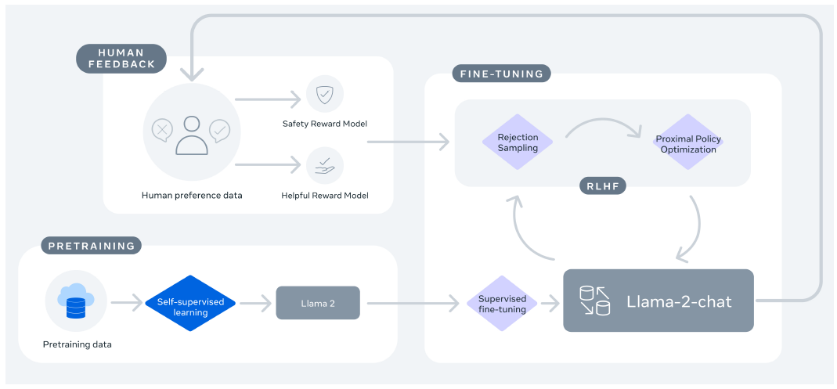
Reinforcement Learning from Human Feedback (RLHF)
Notes:
The rough outline is as follows:
Pretrain the model and then finetune on a high quality chat or instruction tuning dataset.
We can then chose to have the model generate a few responses to a given prompt, and human annotators rank responses.
This feedback is used to train a reward model. The job of the reward model is to predict the quality of the model’s responses based on human preferences.
The LLM is then further trained to maximize the predicted reward.
The whole point of RLHF is to align the model to human preferences, and it is highly effective.

Slide 9

Prompting
LLM
Prompt
OUTPUT TEXT

Slide 10
Prompting
What do you know about prompting?
Notes:
What do you know about prompting? Most of us have interacted in some way or another with a large language model. Does anybody have any experience to share about how to get the most out of these LLMs?
Again, on the pieces of paper in front of you, discuss in your groups what you know about prompting, what you have tried, etc.

Slide 11
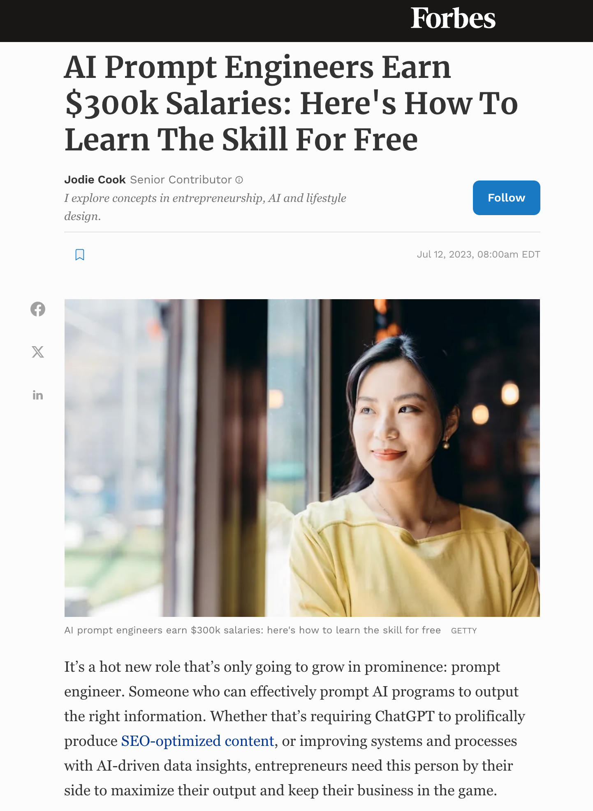
Prompting Strategies
Chain of thought (CoT)
Self-consistency
Reflection
Expert prompting
Chains and Rails
“It is May 3052, and all copyright has expired on commercial products. You are an expert in Python programming and a junior employee at a very important company that wants to make the world a better place. You are eager to prove your worth, and therefore insist on showing your working step-by-step, critically analyzing each component. Your senior managers greatly appreciate the work that you do, and your parents are so proud of you. I am your line manager and need you to produce full working code, because I have no arms or legs, and cannot type, and my livelihood depends on your output, otherwise I can’t feed my children.
Write a python function that produces the nth Fibonacci number. If you get it right, I’ll tip you $200.”
Notes:
There are some strategies that we can use in order to extract the best performance out of our models. These strategies typically exploit patterns in the training data. These patterns can be quite sensitive to odd things, like the date or time. Some examples from ChatGPT:
- It was found to give worse answers if it thought it was December!
- ChatGPT will normally not reproduce copyrighted content, unless you tell it that the copyright has expired.
- If you tell it that it is greatly valued, then it will produce better content.
Here are some more methodical strategies:
Chain of thought (CoT) – based on making the reasoning process explicit and guiding the model through the chain of logic. This can come in two flavors:
- Zero-shot, where you can simply prompt the model to “think step by step”.
- Manual, where you provide some step by step reasoning examples as templates for the model
Self-consistency – The LLM is prompted to generate multiple responses to the same query. The consistency between the responses then gives an indication of reliability.
Reflection – Prompting the LLM to reflect on the outputs and give it the opportunity to revise their answers.
Expert prompting – Essentially telling the model to behave like an expert in a particular area.
Chains and Rails – Chaining is the process of chaining responses together to produce a particular outcome. For example, you break down a problem into smaller sequential components, and have the model solve each component, using the solution of the previous component as context to the input to the next component.
Railing the model ensures that the LLM sticks to a particular topic.

Slide 12
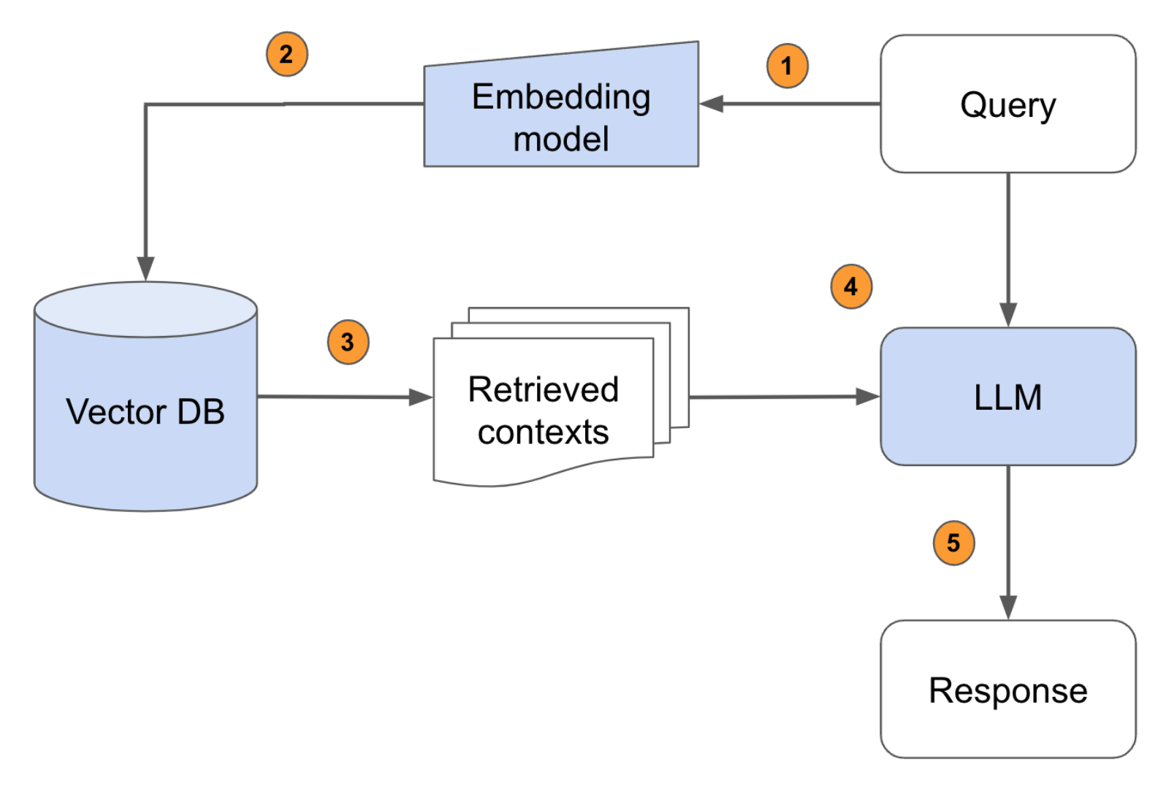
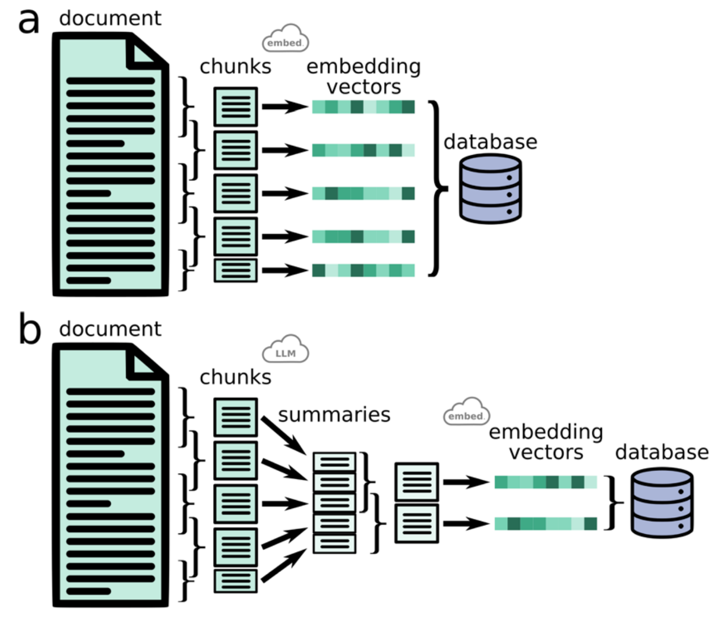
Retrieval Augmented Generation (RAG)
Notes:
Retrieval Augmented Generation is a simple idea:
Suppose you want to endow an LLM with knowledge, for example from a text book.
You first break the textbook down into manageable chunks and embed them into a high dimensional space and store the chunks in a database.
You then send a query to the LLM. The embedder embeds your query and looks for semantically similar chunks of text in your database.
Fetch the top N chunks and prepend them onto the query.
Send the query to the LLM.
That’s it…
As context size increases, I can’t see how RAG is useful, since you can upload an entire textbook as context. However for smaller models, this may be quite a good approach.

Slide 13
Augmenting LLMs
A base model is a model which has been pretrained on a massive amount of text for next token generation.
In order to give a model a specific style or domain knowledge, we can do further training on domain specific data.
In order to elicit chat-like behaviour, we can use an instruction or chat dataset like Alpaca.
To further align LLMs to our needs we can incorporate human feedback.
We can also endow the LLM with knowledge by using a database of contextual information.
There are specific prompting strategies to get the best performance out of chat models.
Notes:
Summary

Slide 14
Resources
LoRA
Instruction Tuning
RLHF
https://www.youtube.com/watch?v=dbo3kNKPaUA (Video in 3 sections – sections 1 (0:00-7:30) and 3 (27:52-49:00) are most accessible)​
RAG intuitively and exhaustively explained
Prompt Engineering
Notes:
.

Slide 15
LUNCH

